Slide 1
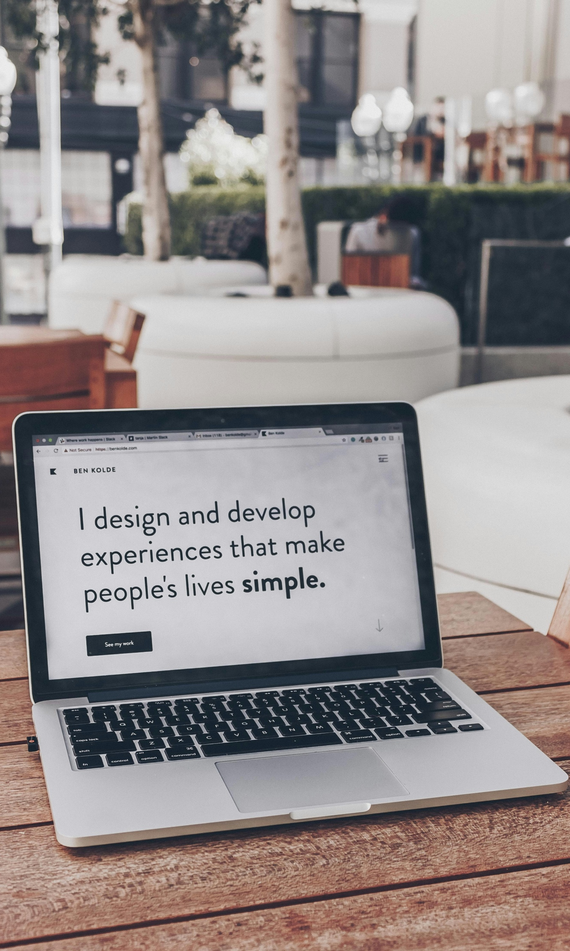

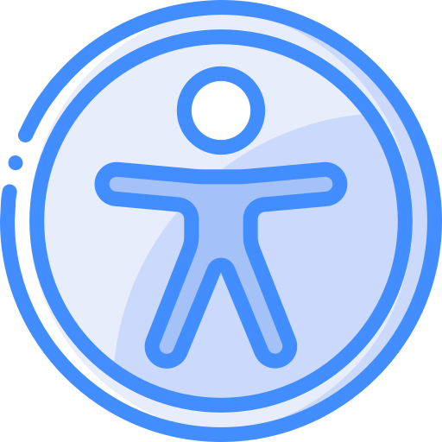
Build For Everyone Not Just The Defaults
Easy Ways to Make Your Web Apps Work for Everyone
NG Delhi - August 2025
Notes:
- Testing of app without mouse?
- Also meaningful
- Discover easy and practical ways

Slide 2

What We’ll Cover
We’ll explore what accessibility really means, why it matters, and how even small changes in our code can make a big difference in someone’s experience.
01.
What is Accessibility?
02.
Why it Matters
03.
Common Pitfalls
04.
Available Tools
05.
Code Demo
06.
AI Meets Accessibility
07.
Tips & Resources
08.
Let’s Test Our Awareness!
09.
Q&A
Notes:
Common mistakes developer makes

Slide 3
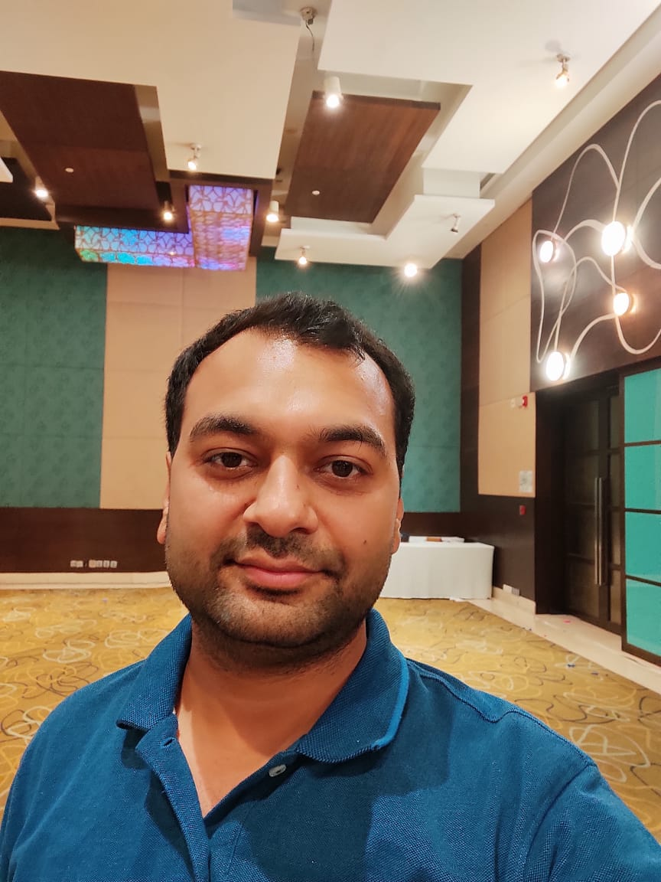





About Me…
Experience
Hobbies & Interests
13+ years in web development
Angular Expert Certified ⭐
10+ years with Angular - from AngularJS to Angular 20
Experienced in BFSI & enterprise apps at Citibank, Deutsche Bank, & Synechron
Currently building low-code/no-code UI frameworks at SBS
Building side-projects
Writing blogs & sharing tech insights
Attending meetups & conferences
Watching movies & playing PC games
Travelling & trying new cuisines
👋Hi, I am
Himanshu Goel
Architect @ SBS, Noida
https://x.com/himanshugoelmca
https://github.com/HimanshuGoel/
https://www.linkedin.com/in/himanshu-goel-mca/

Slide 4

Before We Start…
Everything I’m sharing today reflects my own experience and learnings — not the official view of my company or NG Delhi.
This session is purely for learning and knowledge-sharing.
Some tools or frameworks mentioned may have alternatives — feel free to explore what works best for you!
Also, any logos or screenshots are used for illustration only and belong to their respective owners.
Notes:
- Feel free to think of it like a conversation

Slide 5

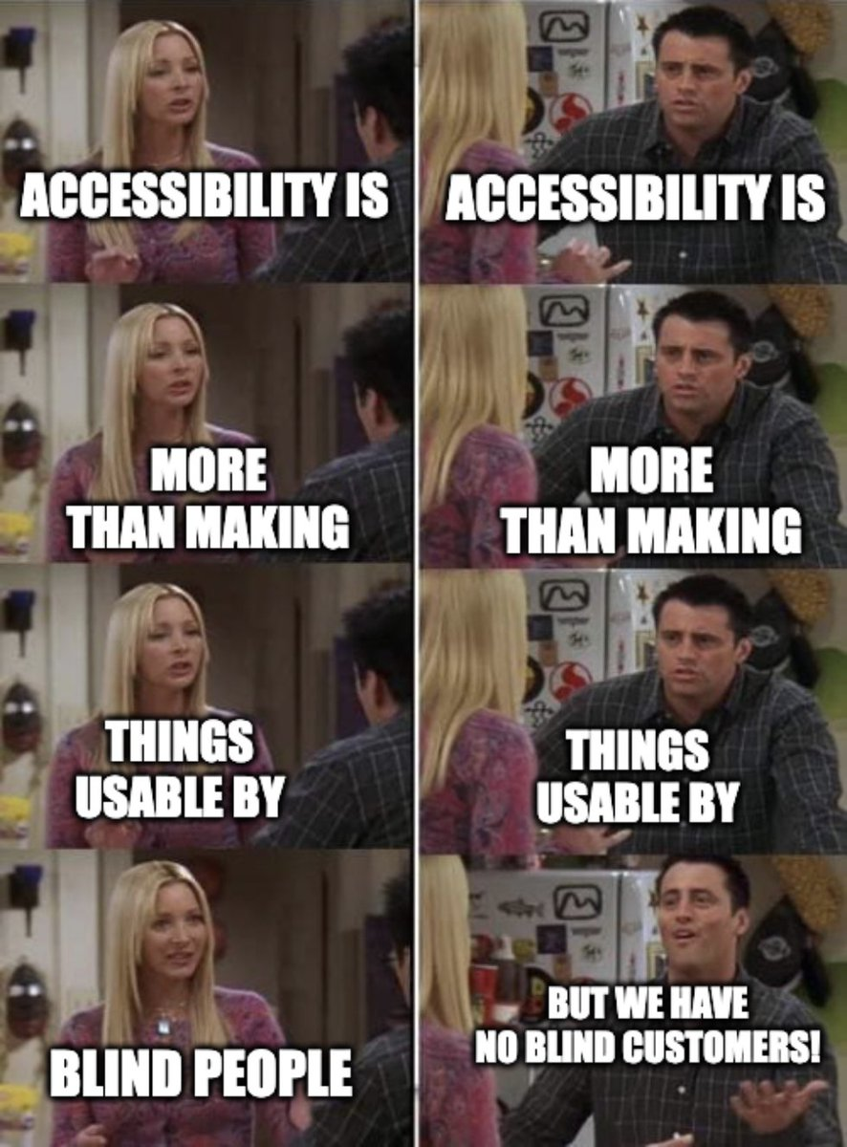
(abbreviated as a11y)
What is Accessibility?
Notes:
a11y represents acronym between a and y
Like responsive design for different size of screens

Slide 6
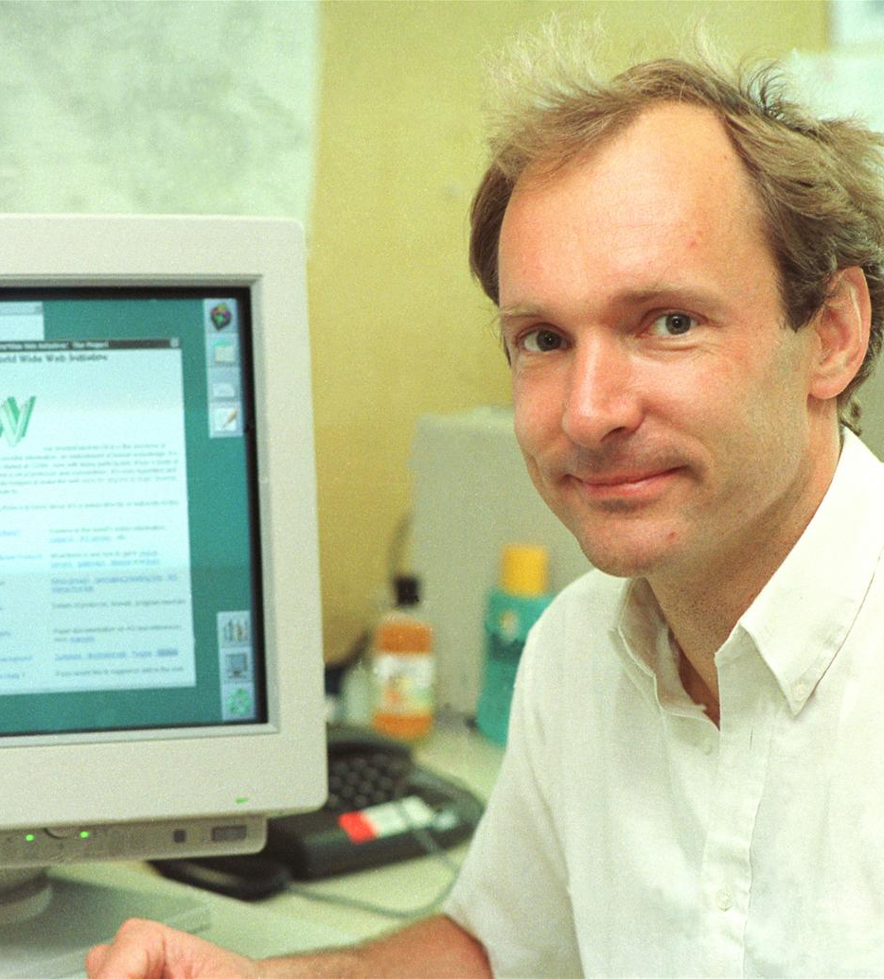

”
The power of the Web is in its universality. Accessibility for everyone, regardless of disability, is an essential aspect.
Tim Berners-Lee → Web Developer
Notes:
Last line – regardless of disability
Foundation principle of web

Slide 7
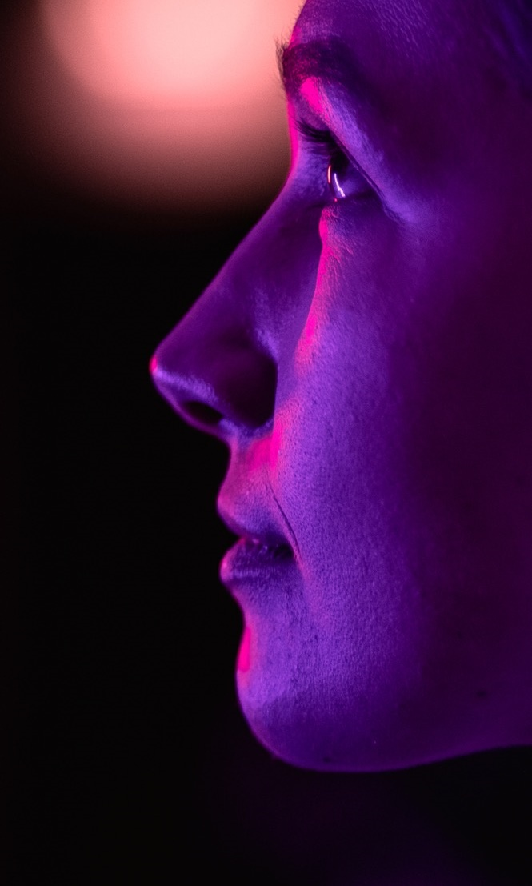
To Put It Simply...
Accessibility means making apps usable for everyone, including people with different disabilities.

Slide 8
To Put It Simply...
Accessibility means making apps usable for everyone, including people with different disabilities.
Seeing
Example: A blind user browsing your app with a screen reader.

Slide 9
To Put It Simply...
Accessibility means making apps usable for everyone, including people with different disabilities.
Seeing
Hearing
Example: A blind user browsing your app with a screen reader.
Example: A user who relies on captions to watch your tutorial video.

Slide 10
To Put It Simply with Examples...
Accessibility means making apps usable for everyone, including people with different disabilities.
Seeing
Hearing
Example: A blind user browsing your app with a screen reader.
Example: A user who relies on captions to watch your tutorial video.
Understanding
Example: A person with learning difficulty needing clear and simple content.

Slide 11
To Put It Simply with Examples...
Accessibility means making apps usable for everyone, including people with different disabilities.
Seeing
Hearing
Example: A blind user browsing your app with a screen reader.
Example: A user who relies on captions to watch your tutorial video
Understanding
Moving
Example: A person with learning difficulty needing clear and simple content.
Example: A user who can't use a mouse and uses only a keyboard.

Slide 12
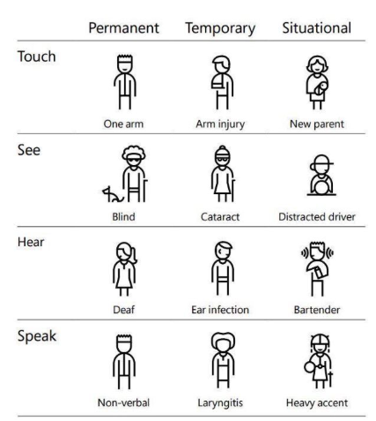
Accessibility also helps people in a variety of situations – not just with long-term disabilities.
Types of Accessibility Needs
Permanent
A person born blind or with a missing limb
Temporary
A broken arm, eye surgery, or ear infection
Situational
Using a phone in bright sunlight
Watching a video in a noisy train
Holding a baby with one hand

Slide 13
Why Accessibility Matters

Slide 14

4 Simple Reasons to Care About Accessibility
Reason #1
Digital Equality
The web is a public space — everyone deserves full access.
It’s not just good tech, it’s digital justice.

Slide 15
4 Simple Reasons to Care About Accessibility
Reason #1
Reason #2
Legal Requirement
Digital Equality
The web is a public space — everyone deserves full access.
Required by laws like Section 508 in US, European Accessibility Act 2025 (EAA).
It’s not just good tech, it’s digital justice.
Based on global standards like WCAG (Web Content Accessibility Guidelines).
Avoids legal risks and promotes ethical responsibility.
Notes:
WCAG principles - perceivable, operable, understandable, robust
2.0, 2.1, 2.2, 3.0 (project silver)

Slide 16
4 Simple Reasons to Care About Accessibility
Reason #1
Reason #2
Legal Requirement
Digital Equality
The web is a public space — everyone deserves full access.
Required by laws like Section 508 in US, European Accessibility Act 2025 (EAA).
It’s not just good tech, it’s digital justice.
Based on global standards like WCAG (Web Content Accessibility Guidelines).
Avoids legal risks and promotes ethical responsibility.
Reason #3
Better Business Outcomes
More users = more reach = more impact.
Improves SEO through semantic HTML and better content structure.
Competitive advantage.

Slide 17

4 Simple Reasons to Care About Accessibility
Reason #1
Reason #2
Legal Requirement
Digital Equality
The web is a public space — everyone deserves full access.
Required by laws like Section 508 in US, European Accessibility Act 2025 (EAA).
It’s not just good tech, it’s digital justice.
Based on global standards like WCAG (Web Content Accessibility Guidelines).
Avoids legal risks and promotes ethical responsibility.
Reason #3
Reason #4
Better Business Outcomes
Promotes Good Design
More users = more reach = more impact.
Many “accessibility features” became everyday features (think dark mode, captions, skip links).
Improves SEO through semantic HTML and better content structure.
It forces you to design with intention, not assumption.
Competitive advantage.
Notes:
- Dark mode or captions become standard features

Slide 18

Accessibility in Numbers
97.4%
Failed at least one WCAG 2.1 AA requirement
71%
Users will leave a site immediately if it is not accessible
5,500
Accessibility lawsuits filed in the U.S. in 2023 alone
$8T
Combined global disposable income of people with disabilities and their families
86%
Accessibility issues are detectable through automation testing – but still ignored
Data sourced from UserWay, WebAIM, 3Play Media, Accessibility Works, Global Business Coalition for Education, and The Valuable 500
Notes:
Not a moral or legal issue – it’s practical one
Why ignored? Priorities, lack of awareness, overconfidence in visual-only checks

Slide 19

Most Common Accessibility Issues 96% of issues fall into these 6 categories
Low-Contrast Text
79.1%
Missing Alt Text
55.5%
No Forms Labels
48.2%
Empty Links
45.4%
General Misconception…
“We are making the web accessible for disabled people — actually, we are making the web accessible for our future selves.”
Empty Buttons
29.6%
Missing Document Language
15.8%
Notes:
- Low-effort high-impact fixes

Slide 20
Common Accessibility Pitfalls

Slide 21

Missing Semantic HTML
Inaccessible
Form
Poor
Keyboard Navigation
Inadequate
Colour Contrast
Relying on
Visual Cues
Alone
No
Alternative Text
Small misses that quietly create big barriers!
Auto-Playing Videos or Sounds
Dynamic Content
Not Announced
Poor
Error Recovery
Notes:
Icons only button (visual cues)
Decorative vs. informative image
The aria-live=“polite” tag

Slide 22
Available Tools for Accessibility

Slide 23

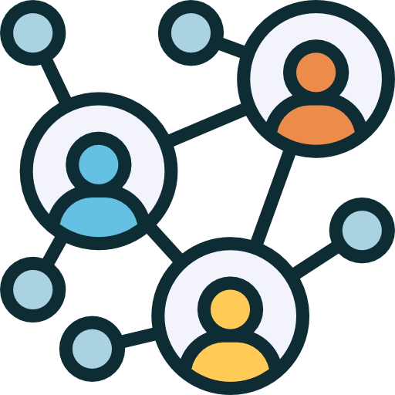
Tools That Make Accessibility Easier
Built-in Angular Support
Third-Party Tooling Support
Angular Material Components
axe-core
Lighthouse
CDK – a11y Package
NVDA
VoiceOver
Built-in Validators and Form Control States
Cypress-axe
Web Developer
Dynamic ARIA Attribute Binding
Accessibility Insights for Web
Wave
Angular Universal
Notes:
CDK – a11y package – focus management, keyboard interaction, screen reader announcements
Built-in – aria-required, aria-invalid, aria-disabled, aria-describedby
Aria-atomic, aria-current, title strategy, live announcer, cdk.a11y-visually-hidden()
Ensure custom components support tabbing, focus
ARIA – Accessible rich internet applications
Zero errors doesn’t mean that it is fully accessible

Slide 24
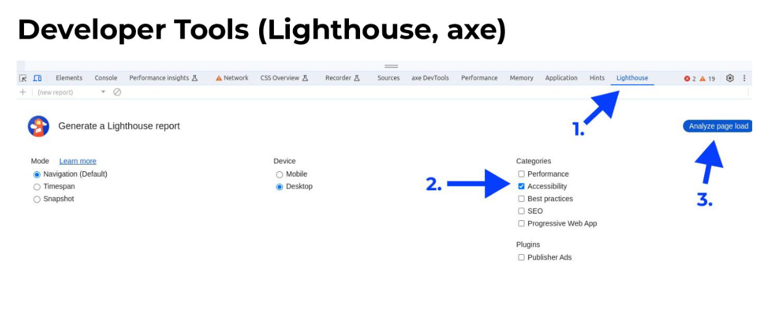
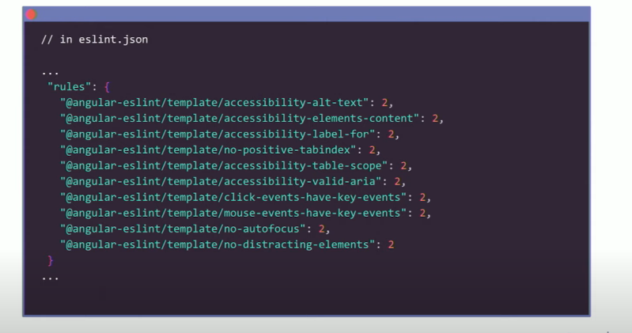
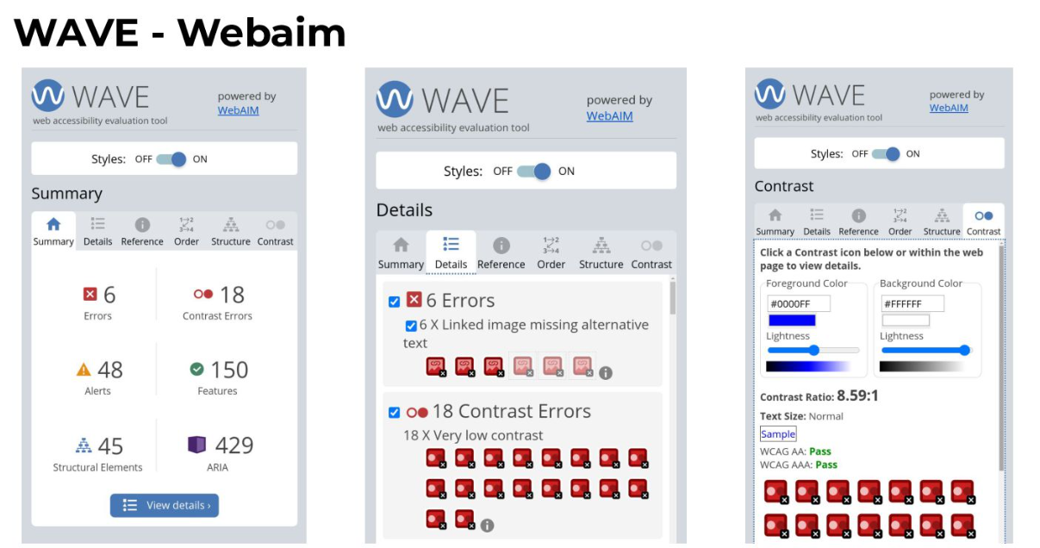
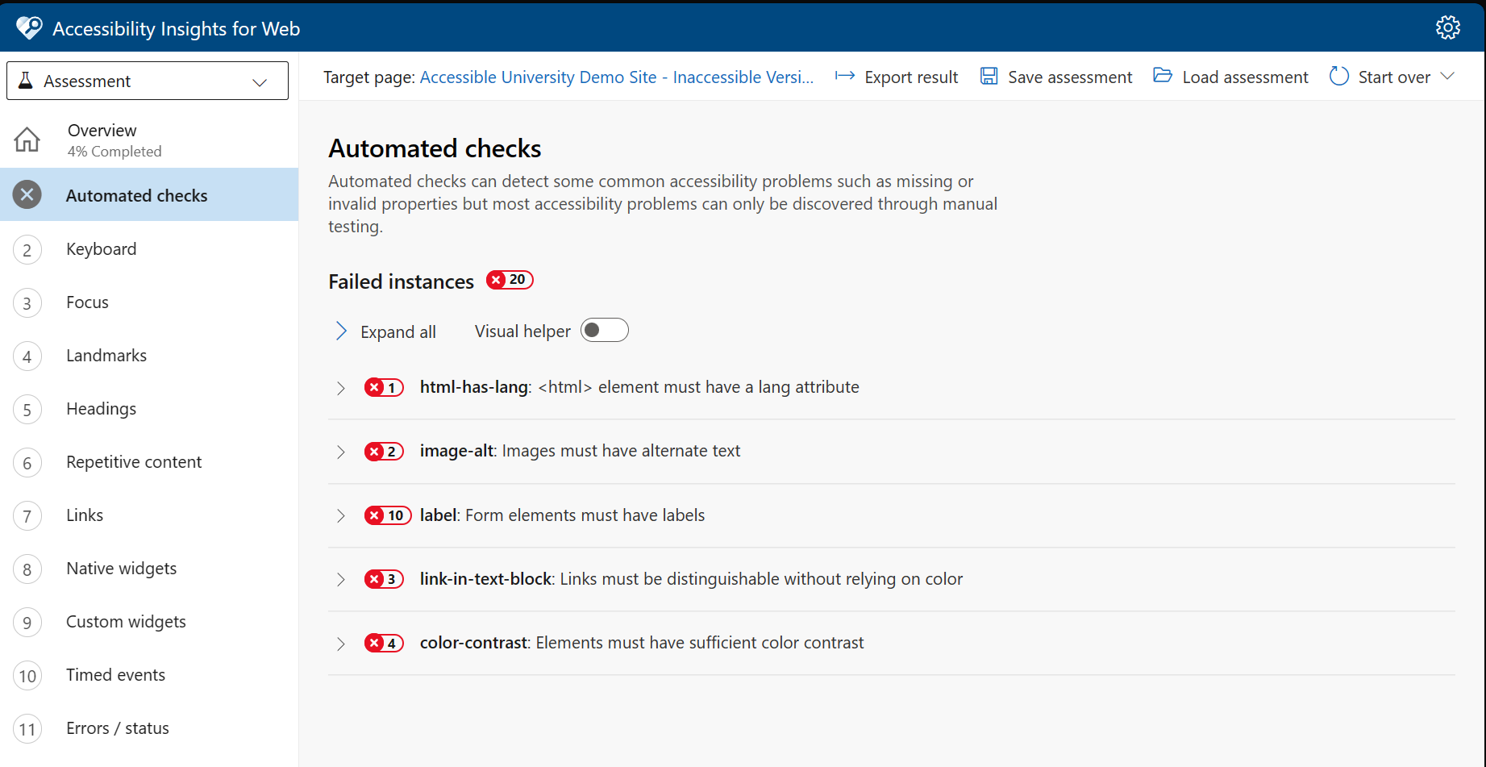

Slide 25
Code Demo

Slide 26
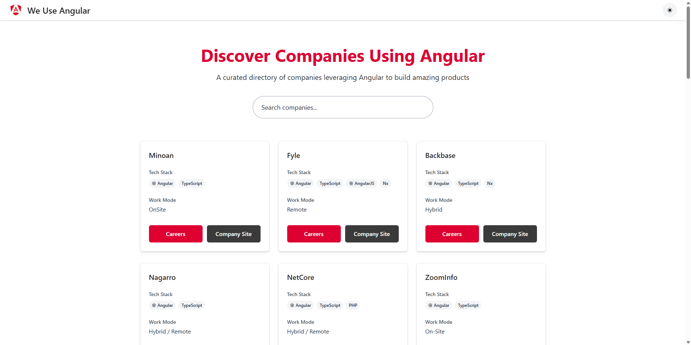

Slide 27
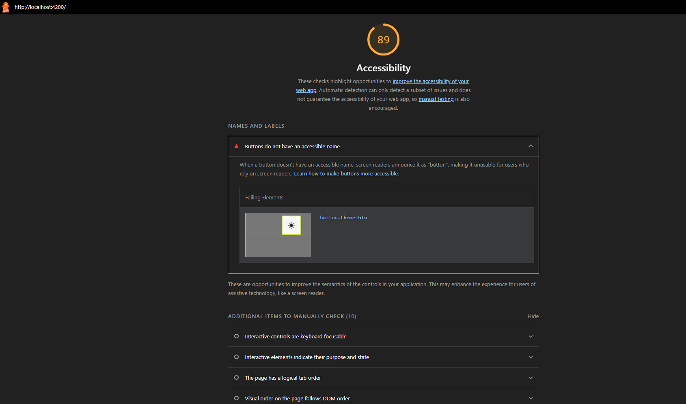

Slide 28
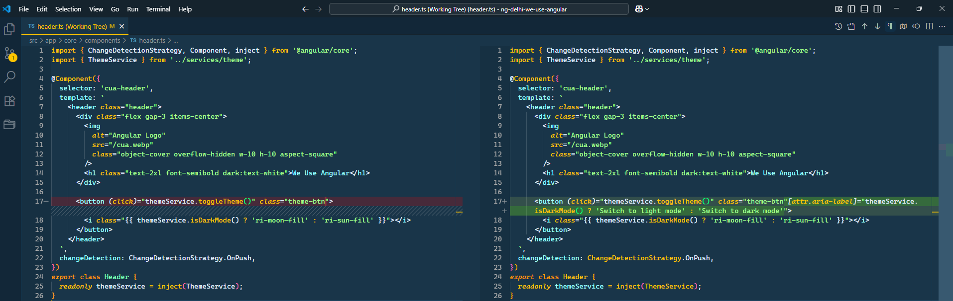

Slide 29
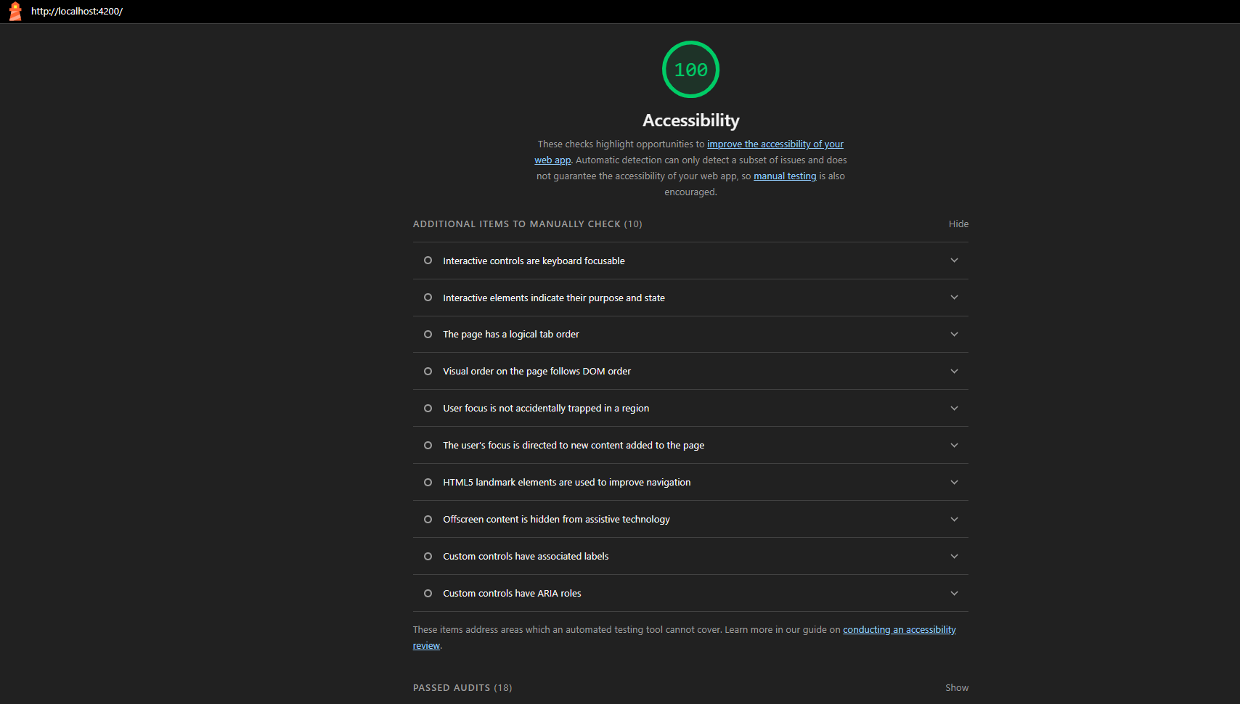

Slide 30
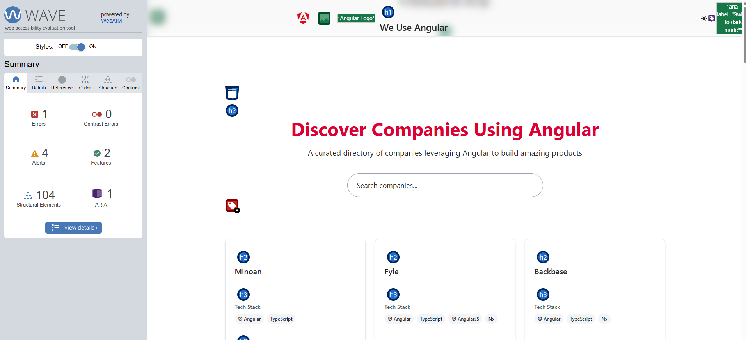
Why the Difference – WAVE Strictly Follows WCAG (Not axe-core)

Slide 31
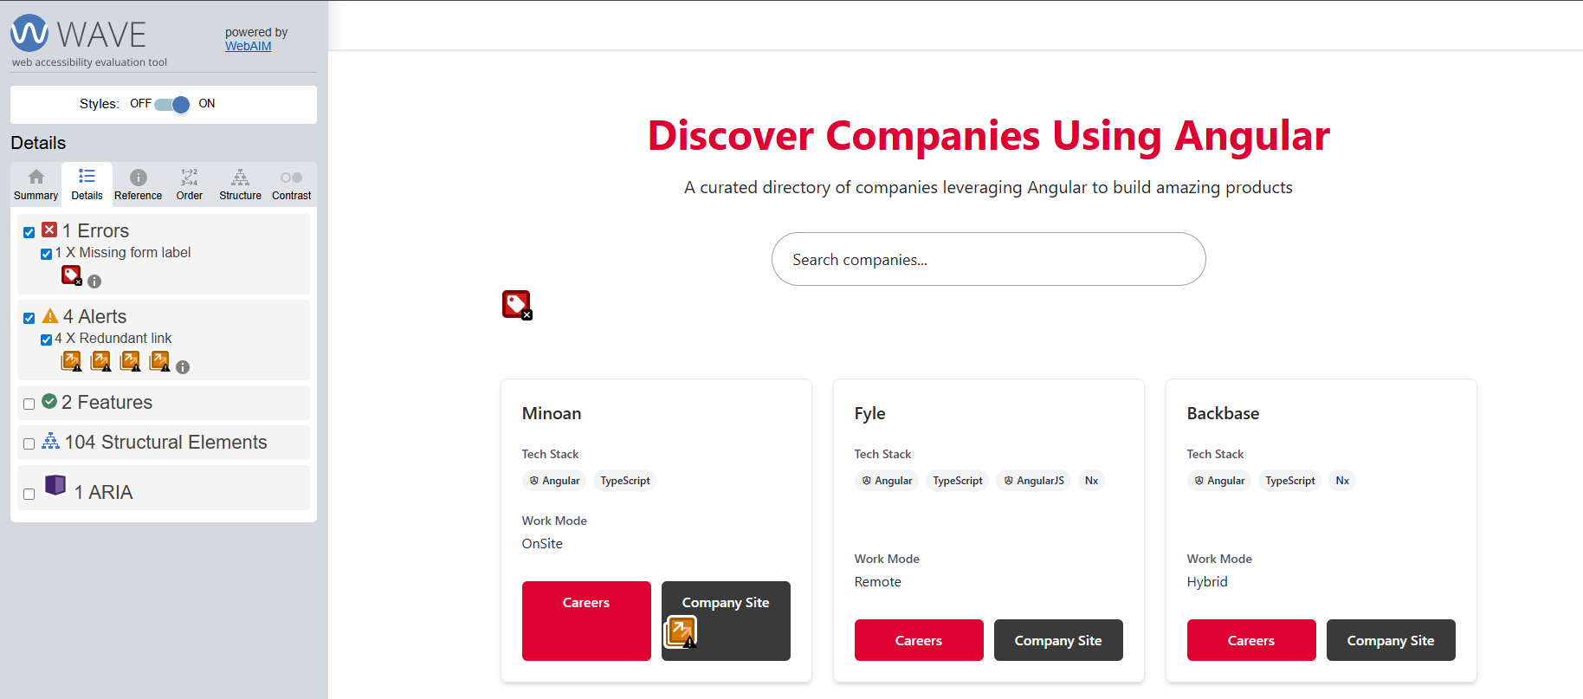

Slide 32
AI Meets Accessibility

Slide 33

How AI is Breaking Accessibility Barriers
Sign Language to Voice/Chat
Tools like Google’s Project Relate, MS AI for Accessibility

Slide 34

How AI is Breaking Accessibility Barriers
Sign Language to Voice/Chat
Personal Helper That Adapts You
Tools like Google’s Project Relate, MS AI for Accessibility
Example - A dyslexic person opens a blog, and AI rewrites the text using easier words automatically

Slide 35

How AI is Breaking Accessibility Barriers
Sign Language to Voice/Chat
Personal Helper That Adapts You
AI that Checks and Fixes Accessibility Issues
Tools like Google’s Project Relate, MS AI for Accessibility
Example - A dyslexic person opens a blog, and AI rewrites the text using easier words automatically
Tools like axe-core + GPT, Evinced

Slide 36

How AI is Breaking Accessibility Barriers
Sign Language to Voice/Chat
Personal Helper That Adapts You
AI that Checks and Fixes Accessibility Issues
Smart Screen Readers
Tools like Google’s Project Relate, MS AI for Accessibility
Example - A dyslexic person opens a blog, and AI rewrites the text using easier words automatically
AI interprets context better than traditional readers
Tools like axe-core + GPT, Evinced

Slide 37

How AI is Breaking Accessibility Barriers
Sign Language to Voice/Chat
Personal Helper That Adapts You
AI that Checks and Fixes Accessibility Issues
Smart Screen Readers
Tools like Google’s Project Relate, MS AI for Accessibility
Example - A dyslexic person opens a blog, and AI rewrites the text using easier words automatically
AI interprets context better than traditional readers
Tools like axe-core + GPT, Evinced
Use Voice Instead of Mouse of Keyboard
Tools like Google Assistant, Alexa for Apps

Slide 38

How AI is Breaking Accessibility Barriers
Sign Language to Voice/Chat
Personal Helper That Adapts You
AI that Checks and Fixes Accessibility Issues
Smart Screen Readers
Tools like Google’s Project Relate, MS AI for Accessibility
Example - A dyslexic person opens a blog, and AI rewrites the text using easier words automatically
AI interprets context better than traditional readers
Tools like axe-core + GPT, Evinced
Use Voice Instead of Mouse of Keyboard
Smart Captions for Videos
AI writes captions for videos—not just words people say, but also sounds or moods
Tools like Google Assistant, Alexa for Apps
Used by Netflix, YouTube. Detected by – Google Sound Notifications

Slide 39

How AI is Breaking Accessibility Barriers
Sign Language to Voice/Chat
Personal Helper That Adapts You
AI that Checks and Fixes Accessibility Issues
Smart Screen Readers
Tools like Google’s Project Relate, MS AI for Accessibility
Example - A dyslexic person opens a blog, and AI rewrites the text using easier words automatically
AI interprets context better than traditional readers
Tools like axe-core + GPT, Evinced
Use Voice Instead of Mouse of Keyboard
Smart Captions for Videos
Emotion-Aware Interface
AI writes captions for videos—not just words people say, but also sounds or moods
If AI sees you’re frustrated or tired, it changes the app to make it easier
Tools like Google Assistant, Alexa for Apps
Used by Netflix, YouTube. Detected by – Google Sound Notifications
Tools like Affectiva, MS Emotion API

Slide 40

How AI is Breaking Accessibility Barriers
Sign Language to Voice/Chat
Personal Helper That Adapts You
AI that Checks and Fixes Accessibility Issues
Smart Screen Readers
Tools like Google’s Project Relate, MS AI for Accessibility
Example - A dyslexic person opens a blog, and AI rewrites the text using easier words automatically
AI interprets context better than traditional readers
Tools like axe-core + GPT, Evinced
Use Voice Instead of Mouse of Keyboard
Smart Captions for Videos
Emotion-Aware Interface
Image Alt Text Generator
AI writes captions for videos—not just words people say, but also sounds or moods
If AI sees you’re frustrated or tired, it changes the app to make it easier
AI can automatically write alt text for images, helping blind users understand what the image shows
Tools like Google Assistant, Alexa for Apps
Used by Netflix, YouTube. Detected by – Google Sound Notifications
Tools like Affectiva, MS Emotion API
Notes:
Human oversight is still important not a hands-off solution

Slide 41
Tips and Resources

Slide 42
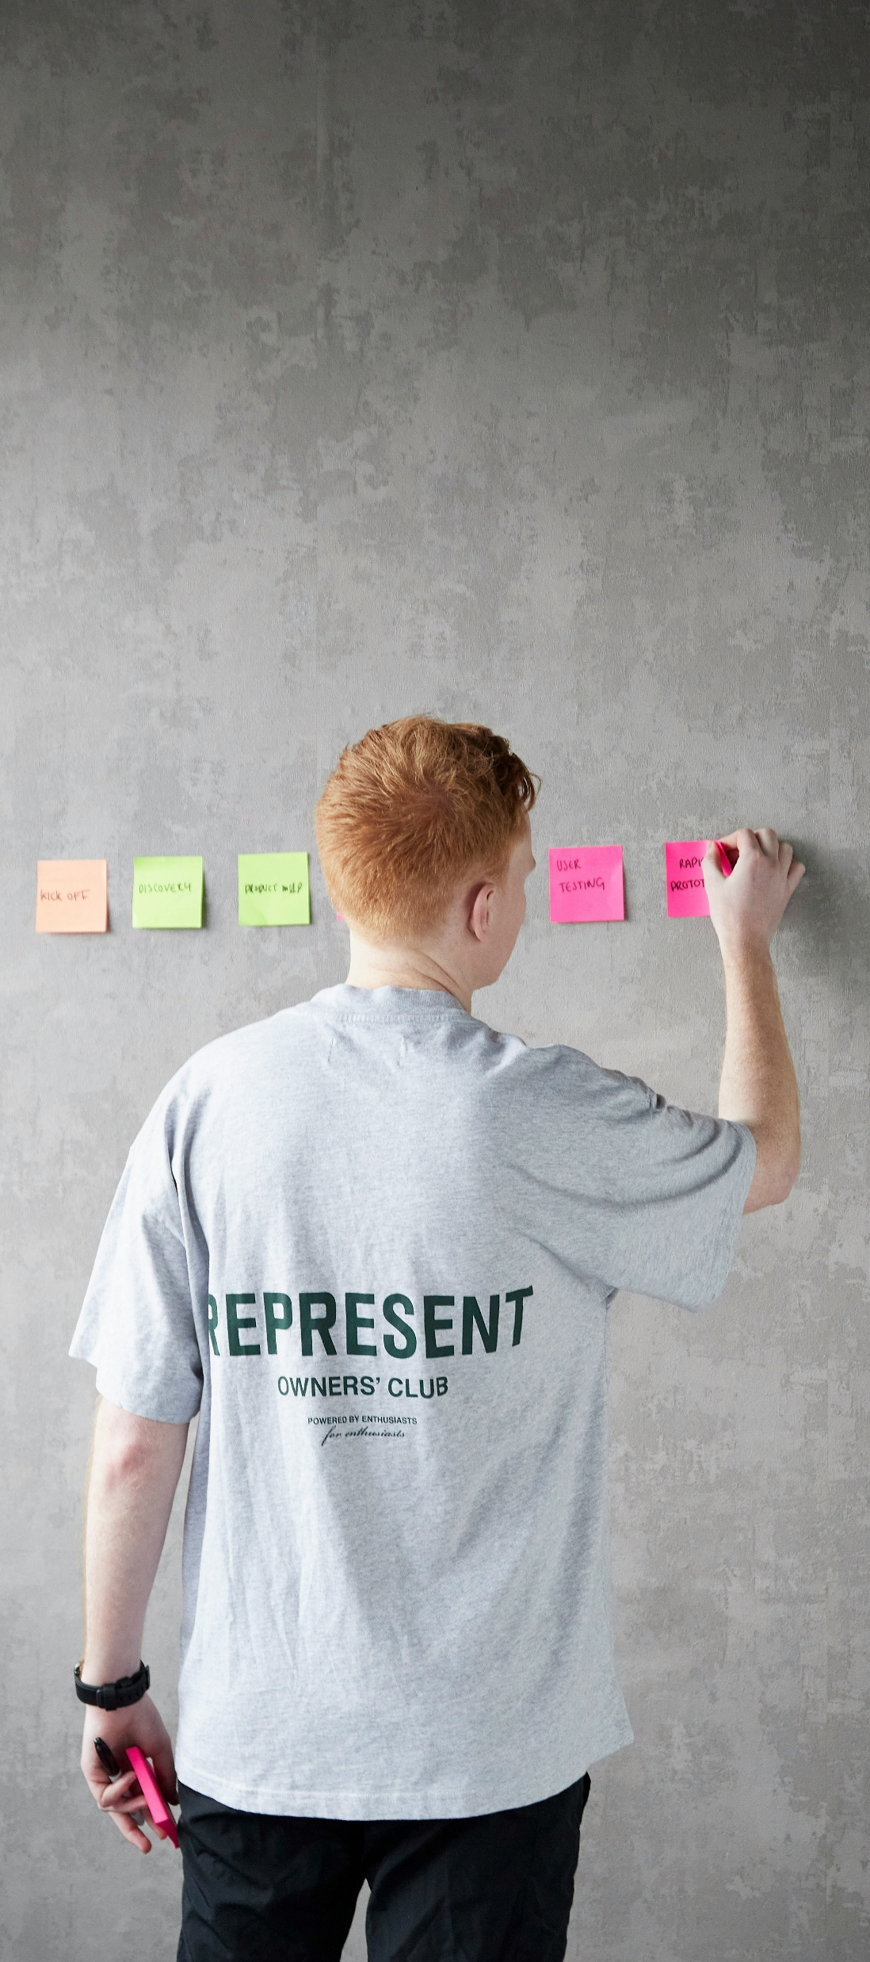
Tips That Help
Start Early
Use Semantic HTML
Think Keyboard First
Test with Real Users
Use Linters
Logs Bugs with a11y in Mind

Slide 43
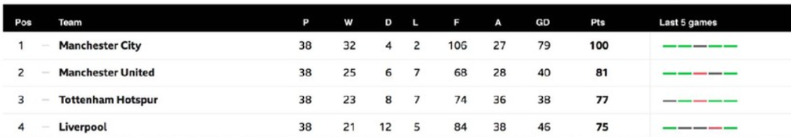
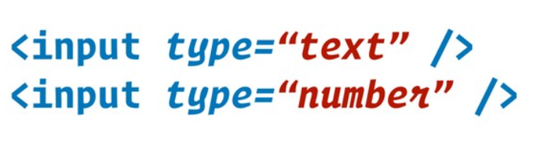
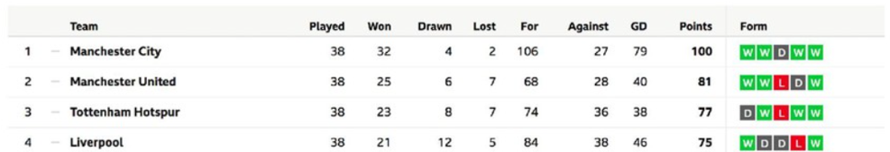
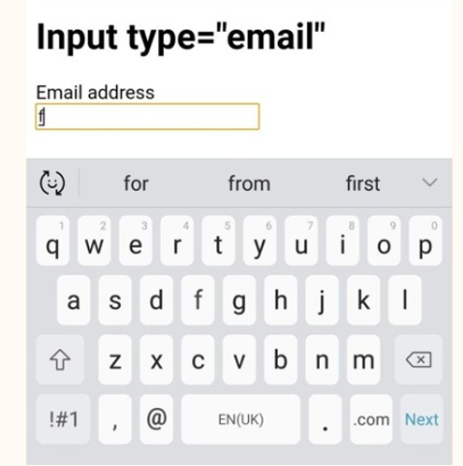
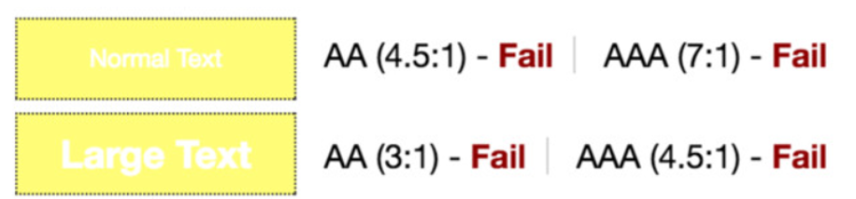
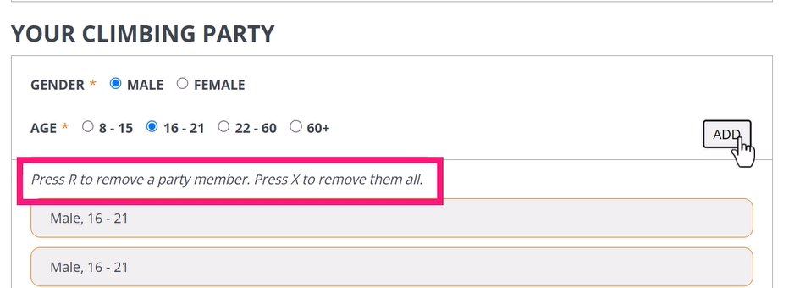
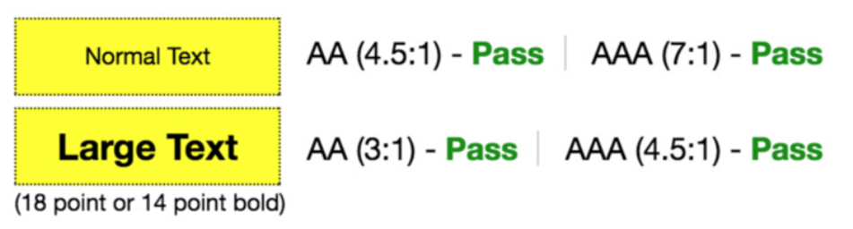

Slide 44
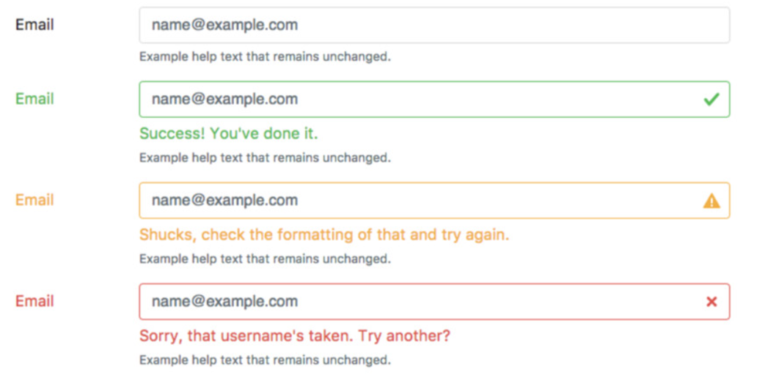
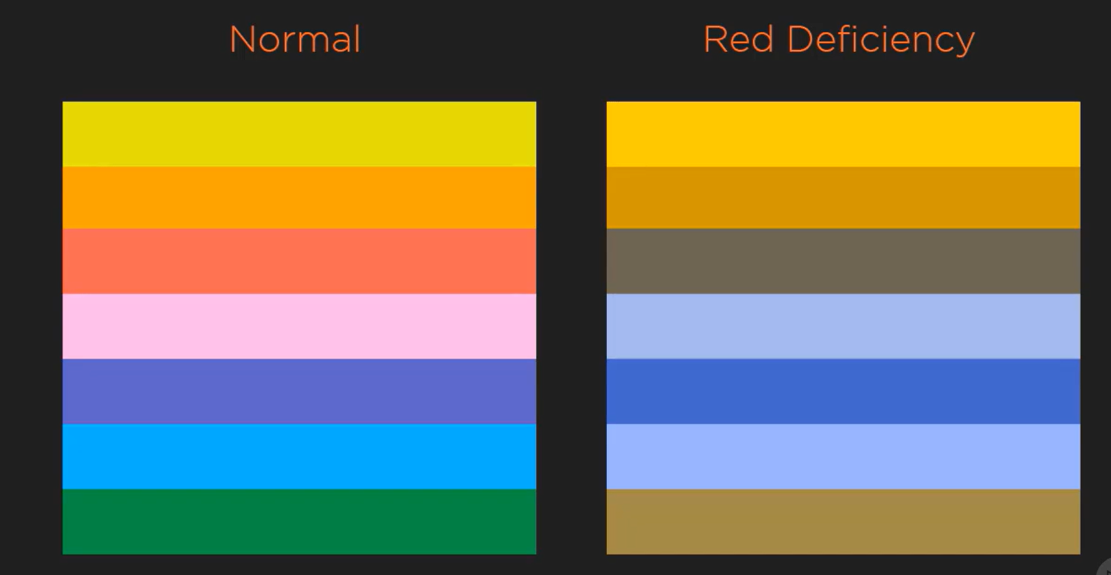
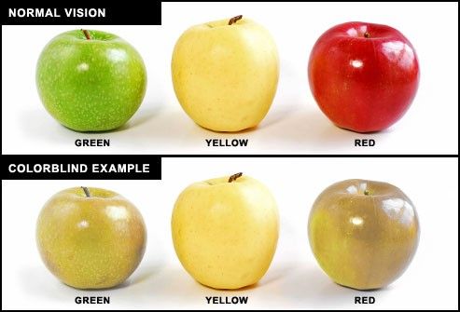
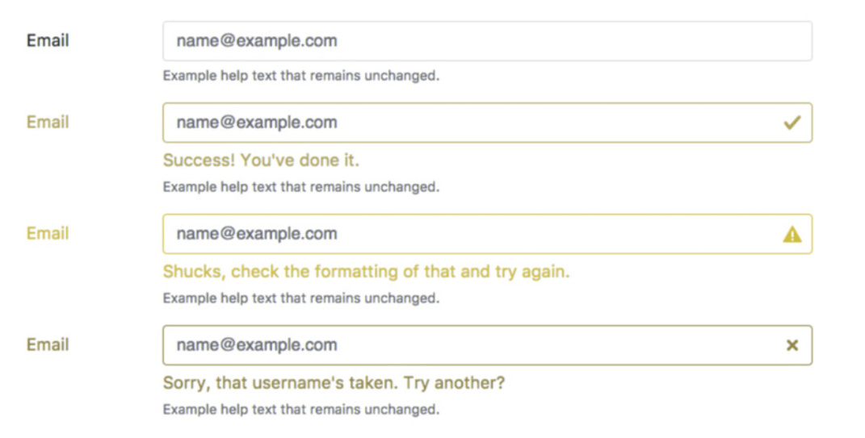

Slide 45
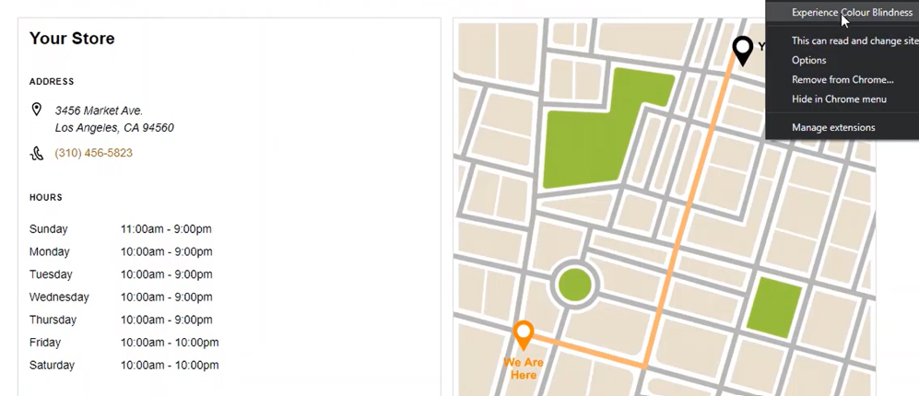
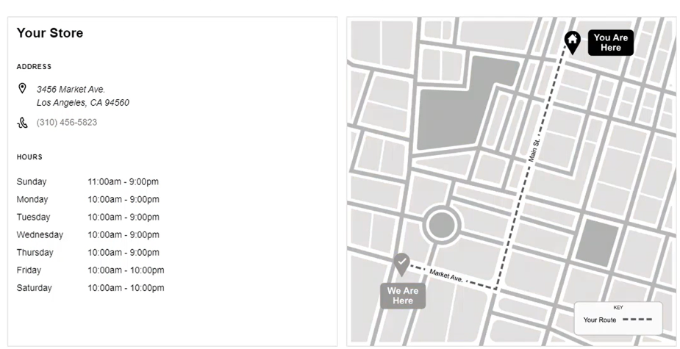
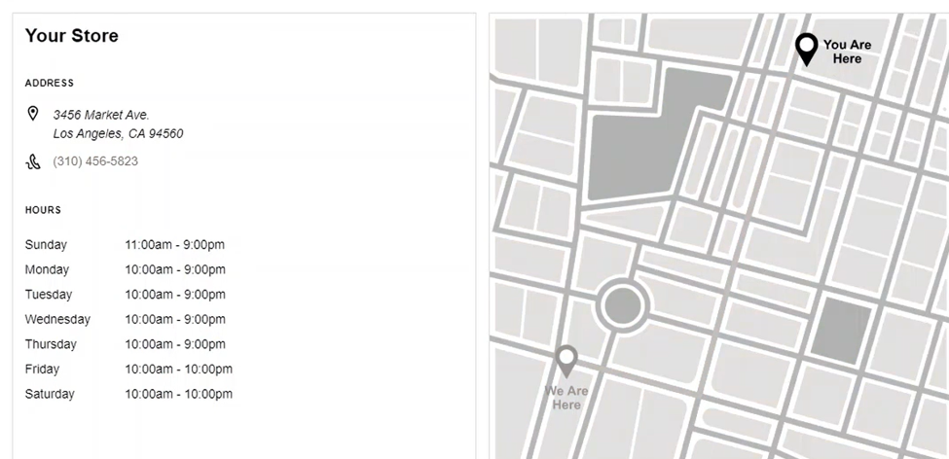

Slide 46
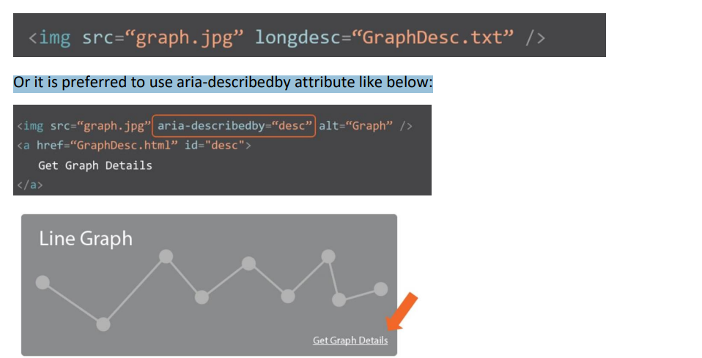
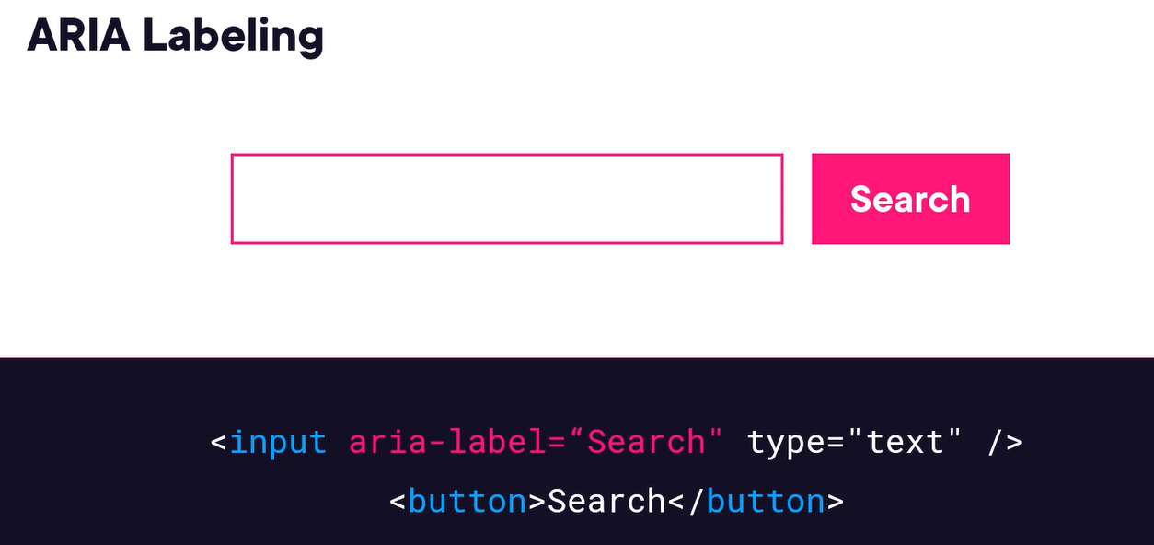
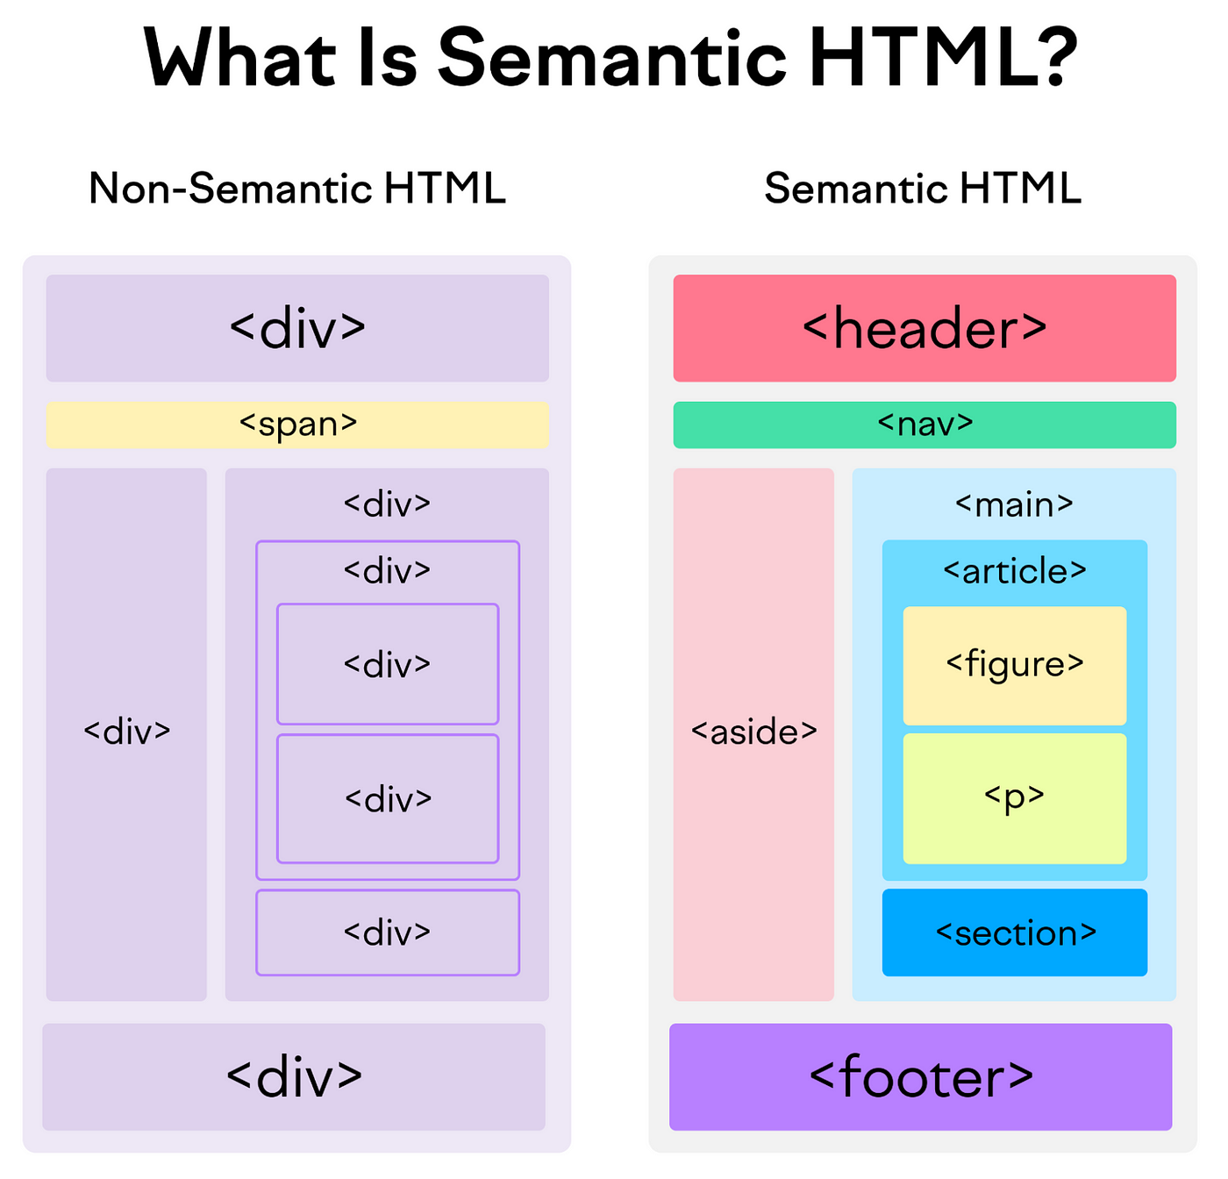
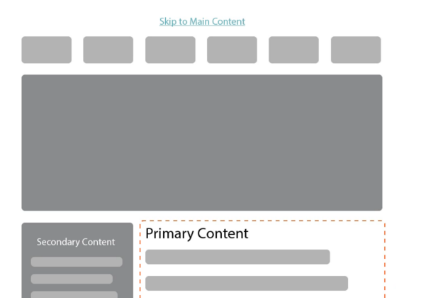

Slide 47
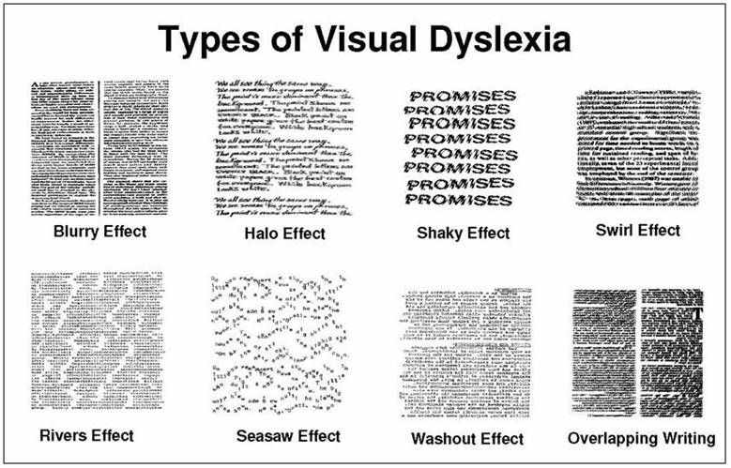
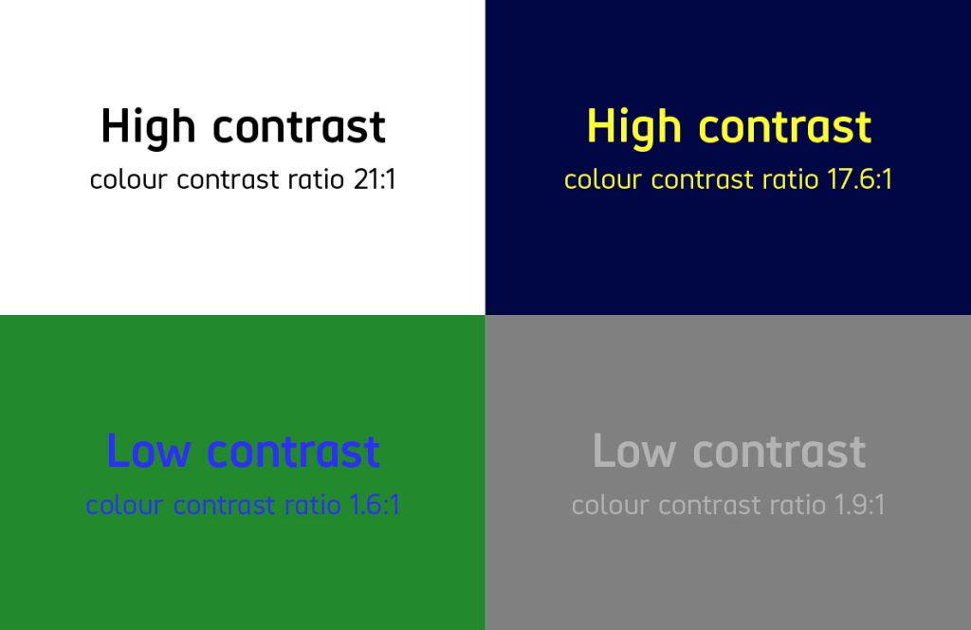

Slide 48
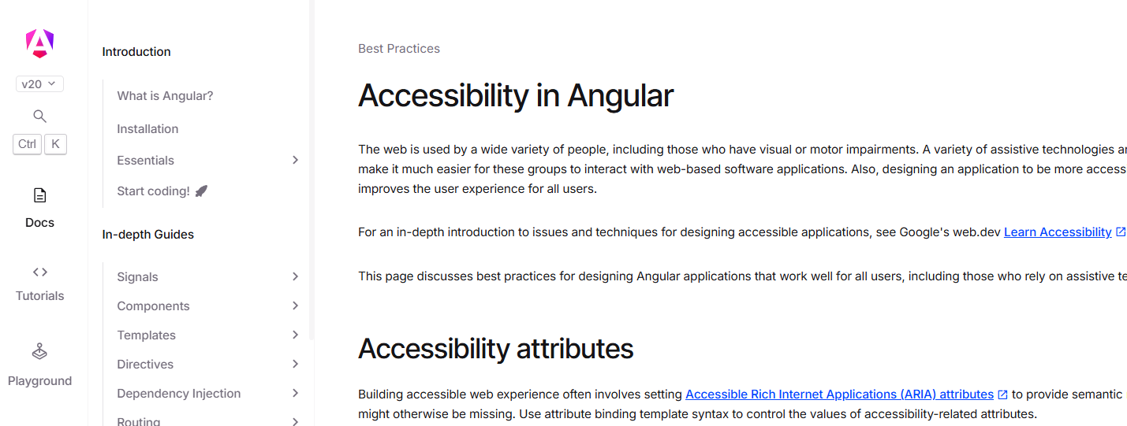
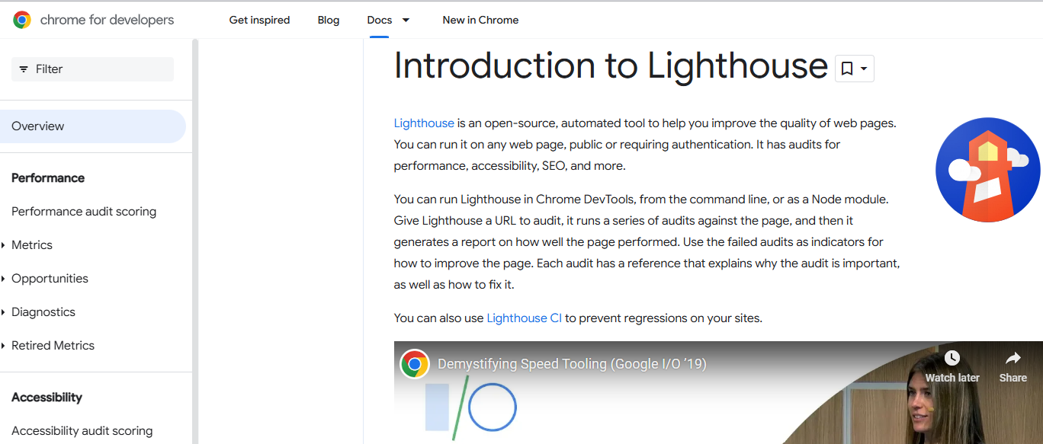
Learning Resources
Accessibility in Angular
https://angular.dev/best-practices/a11y
Web Content Accessibility Guidelines (WCAG)
https://www.w3.org/WAI/standards-guidelines/wcag/
Microsoft Inclusive Design Toolkit
https://inclusive.microsoft.design/
Google Lighthouse
https://developer.chrome.com/docs/lighthouse/overview/

Slide 49
Let’s Test Our Awareness!

Slide 50


Slide 51
What disorder does the character in the movie suffer from?
Dyslexia
A boy has trouble reading and writing.
Use readable fonts like OpenDyslexic or avoid overly decorative fonts.
Keep layout clean, with proper spacing and high contrast.
Use simple language and short paragraphs.
Avoid flashing animations or confusing navigation.
What can we do on our website/app?

Slide 52
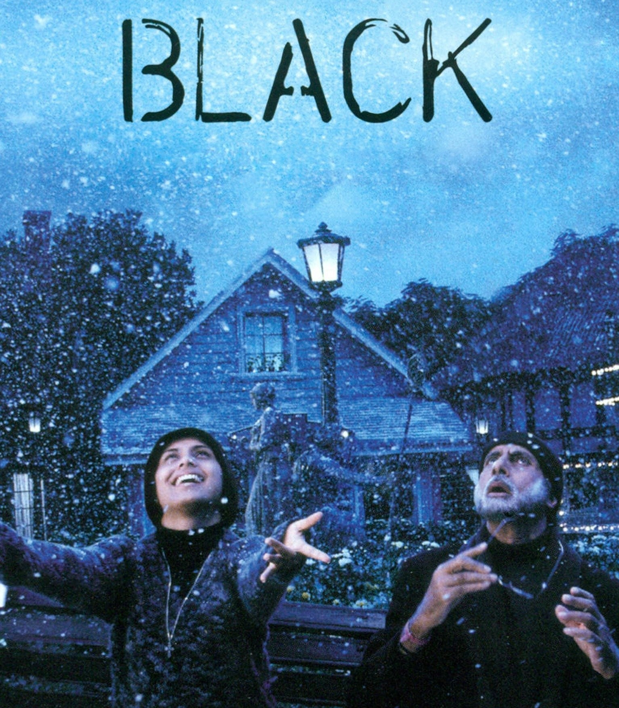

Slide 53
Deaf and Blind
A girl cannot see or hear.
Story of how support and empathy can change a life.
What disorder does the character in the movie suffer from?
Ensure keyboard accessibility (don’t rely only on mouse).
Provide screen reader support (use proper HTML semantics and ARIA roles).
Add transcripts or captions for all media.
Use ALT text for all images.
Ensure buttons, links, and headings are clearly defined.
What can we do on our website/app?

Slide 54
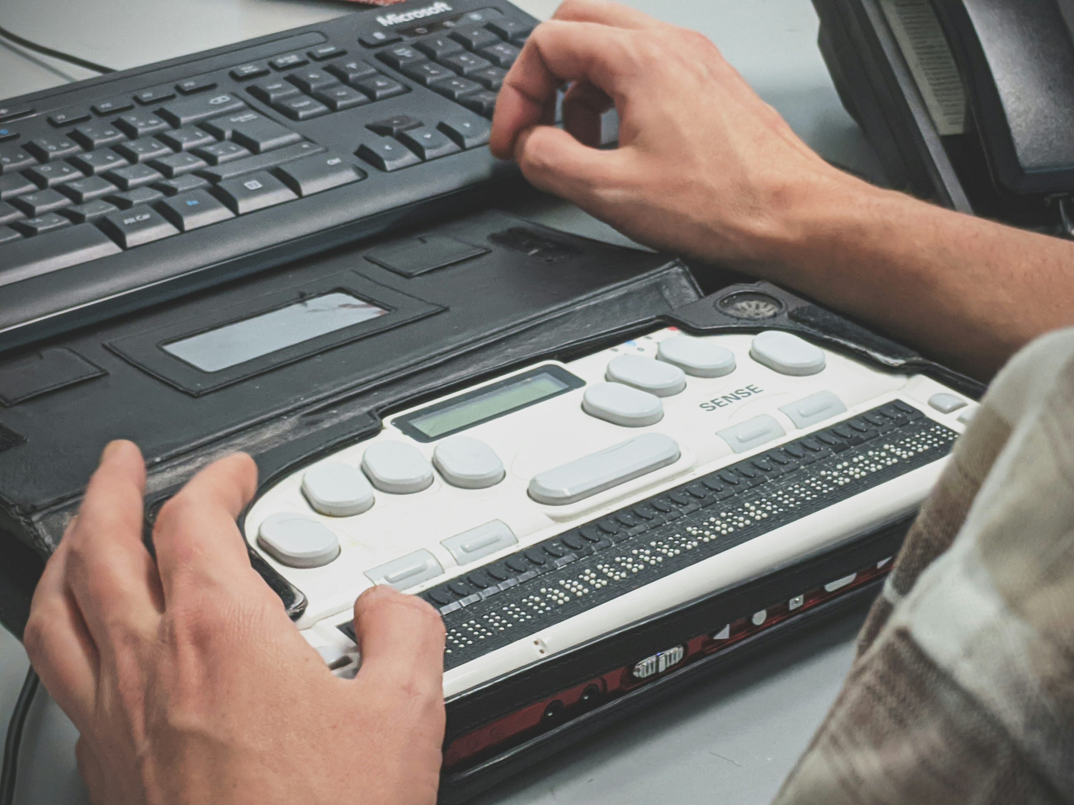
Braille

Slide 55


Slide 56
What disorder does the character in the movie suffer from?
Mild intellectual disability (low IQ).
Story about a simple man with big life experiences.
Use simple, plain language for content.
Include audio/visual guidance instead of text-heavy instructions.
Design with clear navigation and large clickable elements.
Offer text-to-speech support.
Avoid time-based actions or complicated user flows.
What can we do on our website/app?

Slide 57



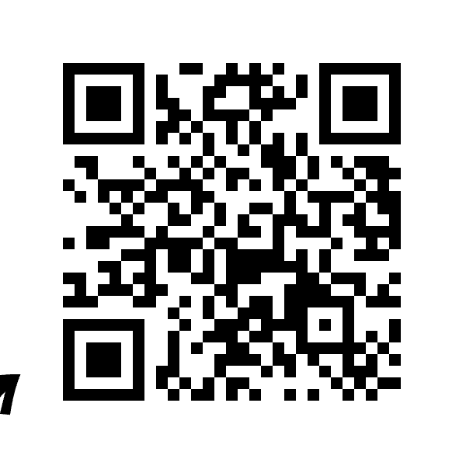
Thank You!
NG Delhi
&
Everyone Here
Himanshu Goel
A Member of the NG Delhi Mentor Team
Notes:
More aware, more empathetic, more ready
Make great and beautiful apps for everyone

